Slide 1
Chapter 8: Main Memory
April, 2024

Slide 2
Chapter 8: Memory Management
Background
Memory Management Tasks
Virtual memory management
Segmentation and Paging

Slide 3
Objectives
To get an overall idea of virtual memory space
To discuss hardware support for virtual memory: segmentation and paging

Slide 4
Background

Slide 5
Program on disk
0
ELF header
Maps contiguous file sections to runtime memory segments
Program header table
.init
Read-only memory segment
(code segment)
.text
.rodata
.data
Read/write memory segment
(data segment)
.bss
.symtab
.debug
Symbol table and debugging info are not
loaded into memory
.line
Describes object file sections
.strtab
Section header table
Notes:
Code segment:
字符串字面量和常量表达式通常在编译时确定，并在程序的代码段中以只读的形式存在。
这意味着它们在程序的整个生命周期内不会被修改，并且可以被多个进程共享
Data Segment：
数据段是内存中用于存储全局变量和静态变量的部分。

Slide 6
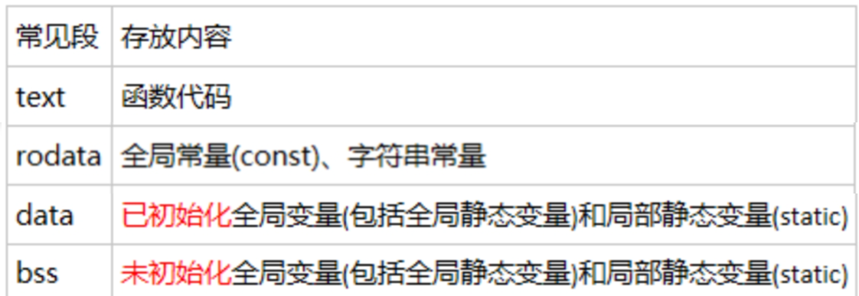
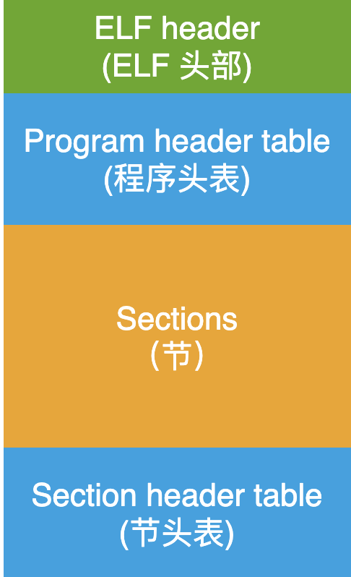
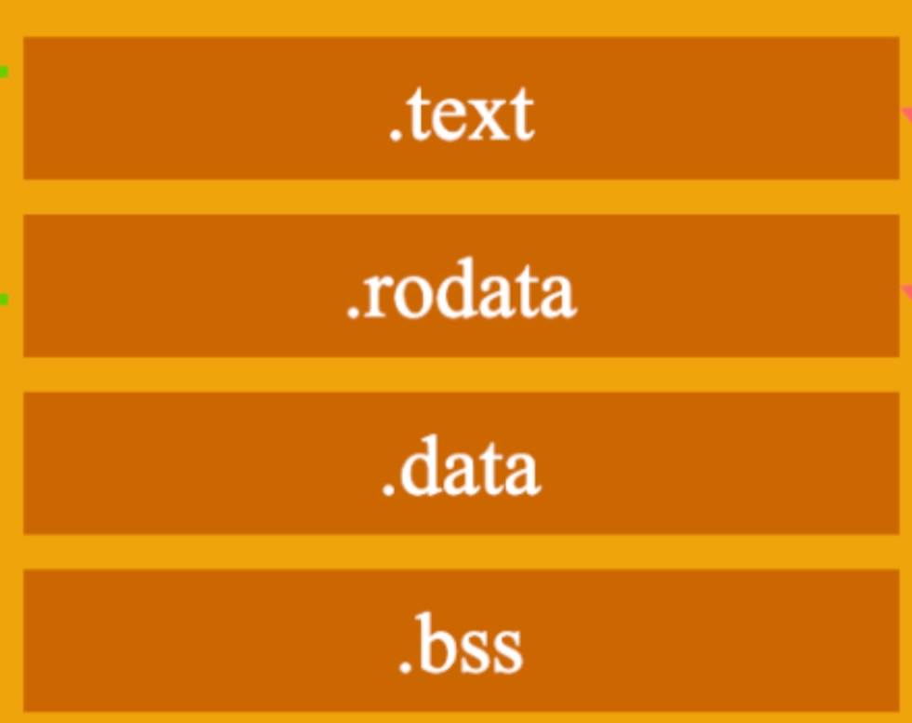
Program on Disk
Notes:
bss是英文Block Started by Symbol的缩写（奇怪的历史遗留），用于存放编译阶段无法确定的全局数据，包括未初始化的全局变量和静态变量。可执行程序不含bss段，只记录区域大小；进程为bss段开辟内存空间，并清零。从优化的角度出发，初始化为零的全局变量，也会被放进bss段从大压缩可执行文件的大小。

Slide 7
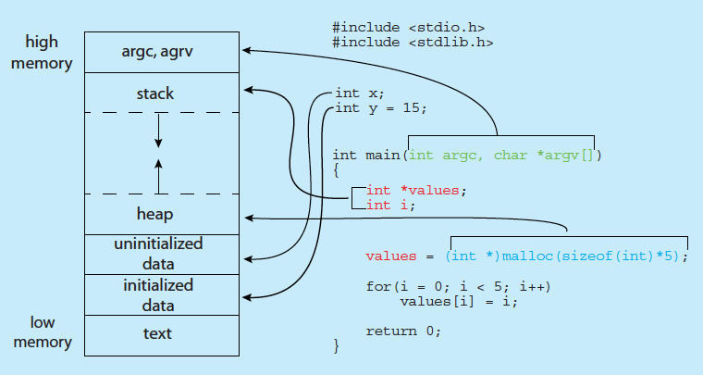
Process in Memory
Notes:
size command
cat /proc/<pid>/maps

Slide 8
Process Resources
Program counter – location of instruction to next execute
CPU registers – contents of all process-centric registers
Memory-management information – memory allocated to the process
I/O status information – I/O devices allocated to process, list of open files
All in PCB

Slide 9
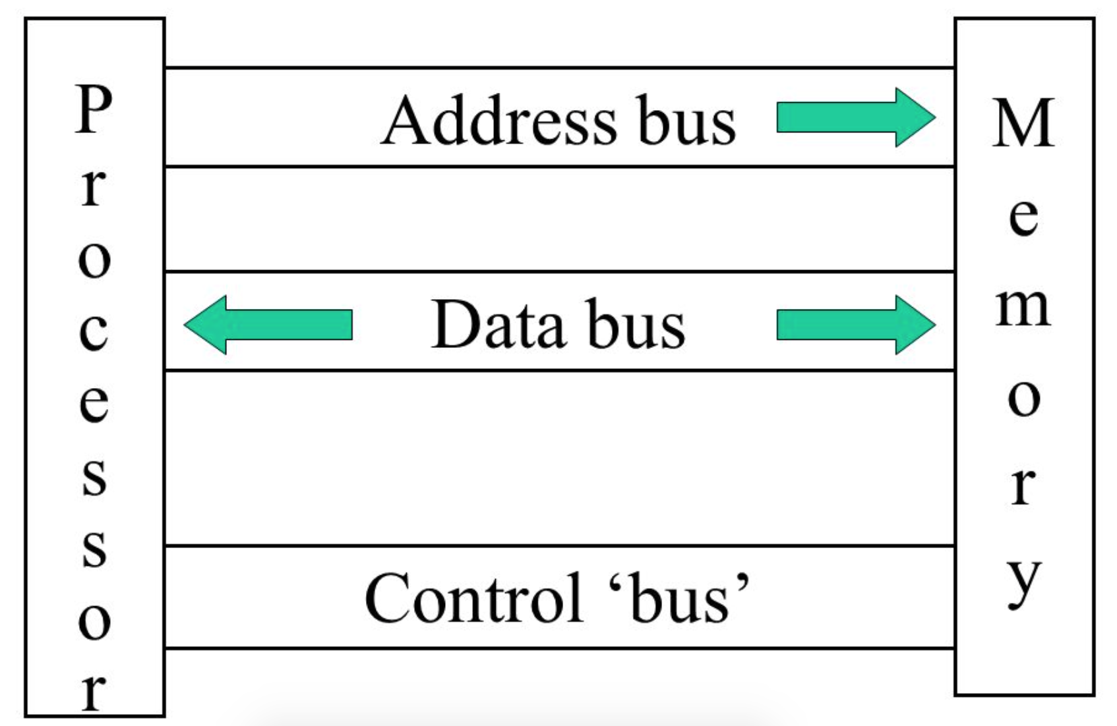
Summary
Main memory (and cache) and registers are only storage CPU can access directly
Program must be brought (from disk) into memory and placed within a process for it to be run
Memory unit only sees a stream of addresses + read requests, or address + data and write requests

Slide 10
Memory Management

Slide 11
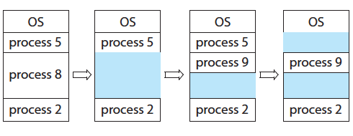
Memory Allocation and Reclaim(回收)
Multi-programming

Slide 12
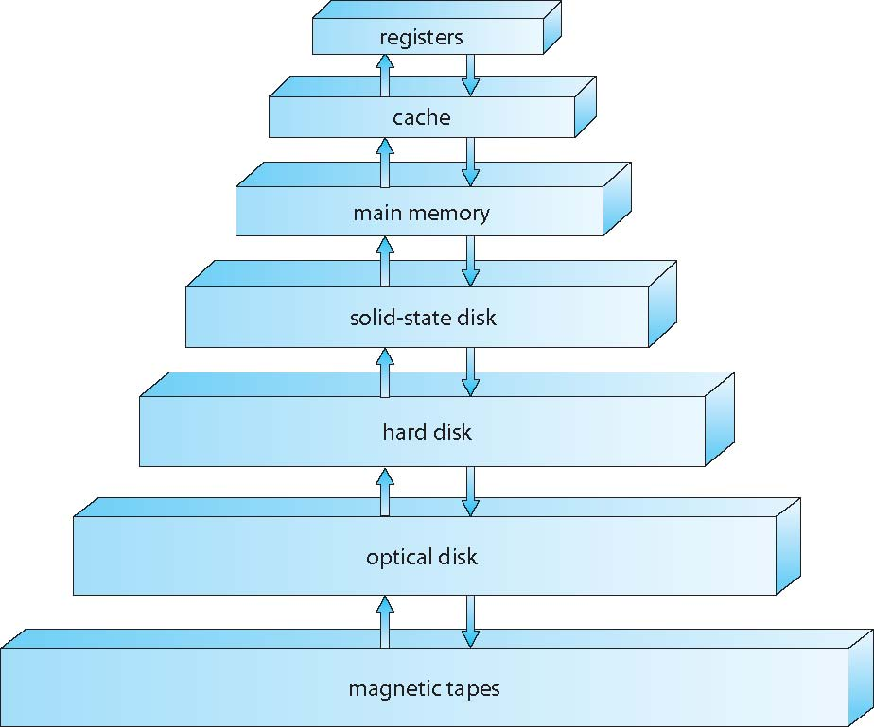
Memory Hierarchy

Slide 13
Performance of Various Levels of Storage
ns us ms

Slide 14
Memory Access Speed
Register access in one CPU clock (or less)
Main memory can take many cycles, causing a stall（停顿）
Cache sits between main memory and CPU registers
How to reduce average memory access time?

Slide 15
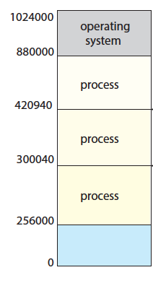
Memory Isolation and Access Control
Read-only memory
demo
Notes:
Demo: segment fault

Slide 16
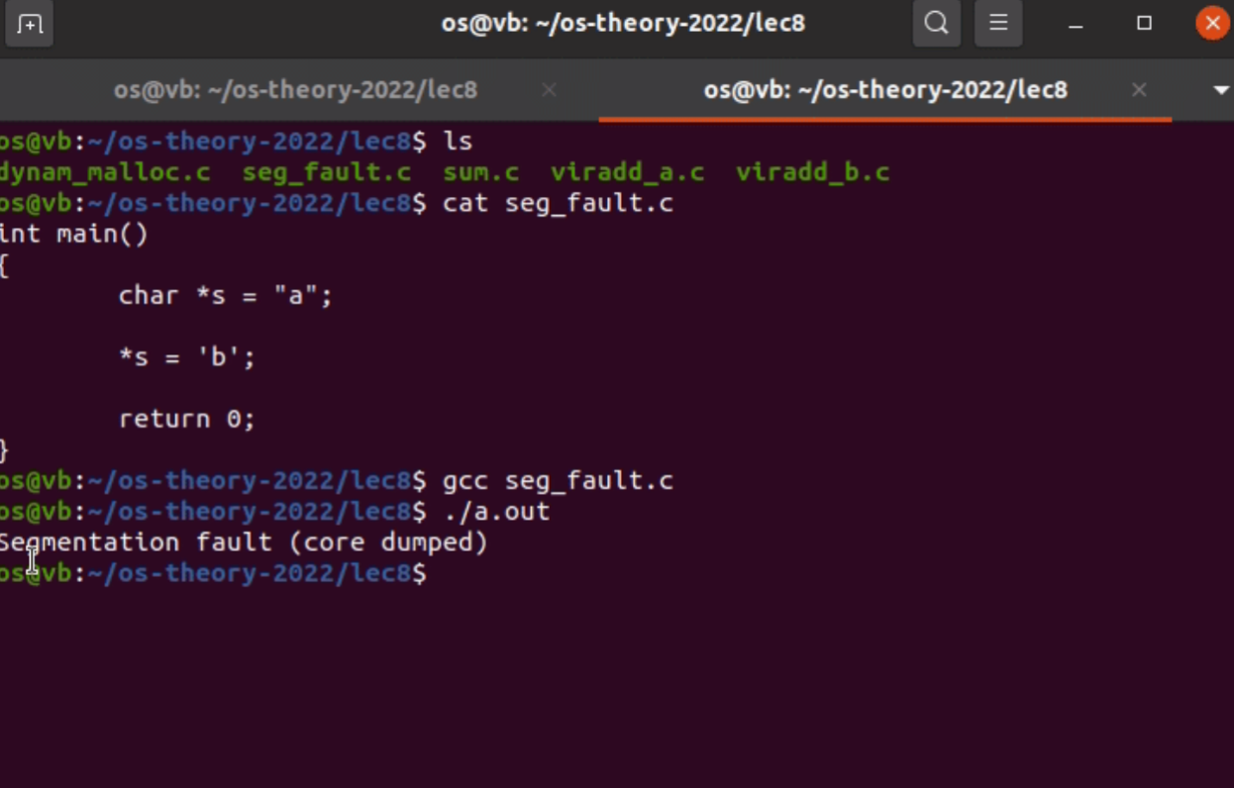
Read Only Memory
Notes:
s作为常量在code segment中，也就是在read only memory中，无法修改导致segmentation fault

Slide 17
Summary
Memory Space Usage Efficiency
Memory Access Efficiency
Memory Protection

Slide 18
Thinking About
./a.out
How much memory to be allocated?
How much memory at most?
Which part of free memory space is allocated?
If a.out is run twice, will the memory space allocated to it be the same? If not, will the execution of a.out be affected?
How to prevent other processes from accessing the memory space of a.out?

Slide 19
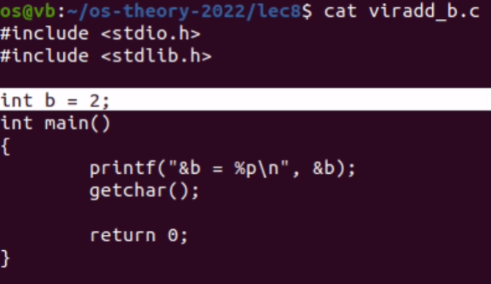
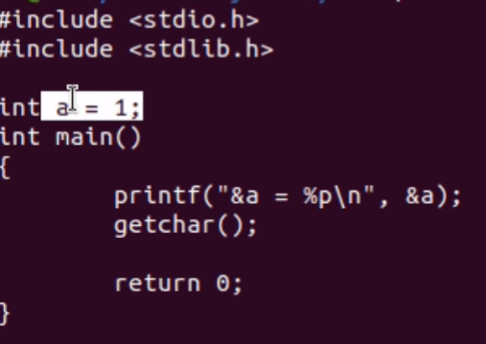
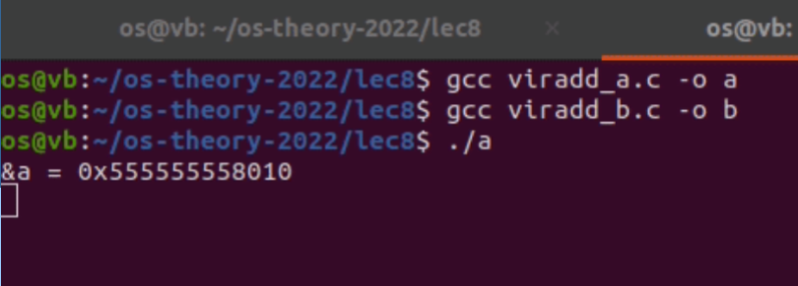
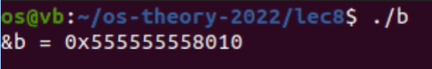
Demo 1
Notes:
为什么两块地址一样？因为这是虚拟地址，两个进程管理自己的虚拟地址，映射到不同的物理地址中

Slide 20
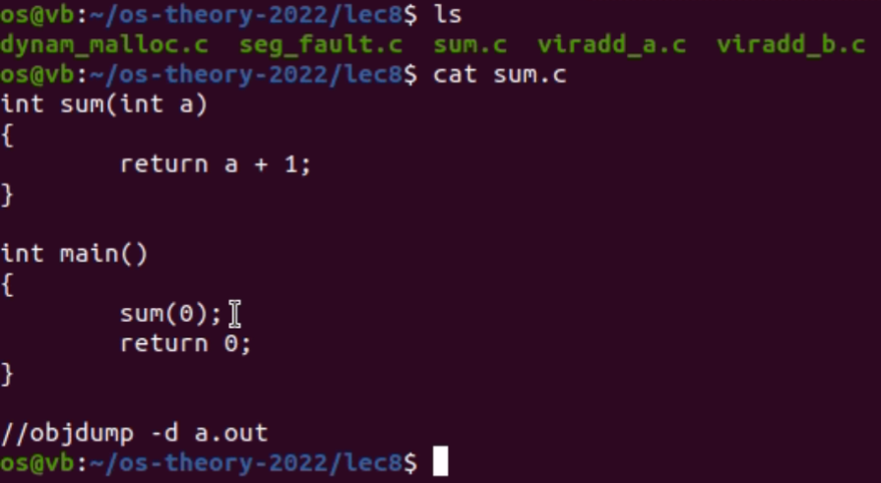
Demo 2

Slide 21
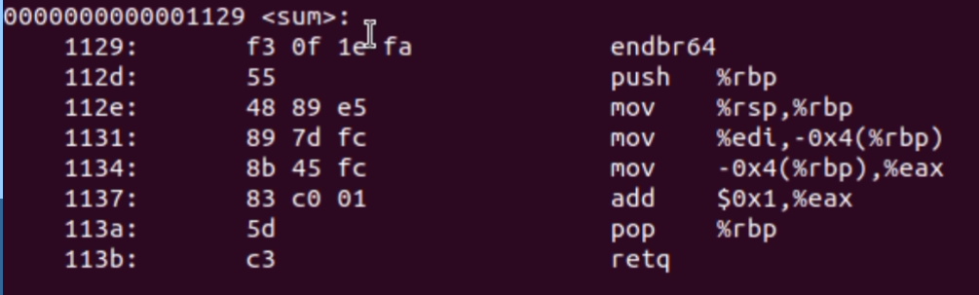
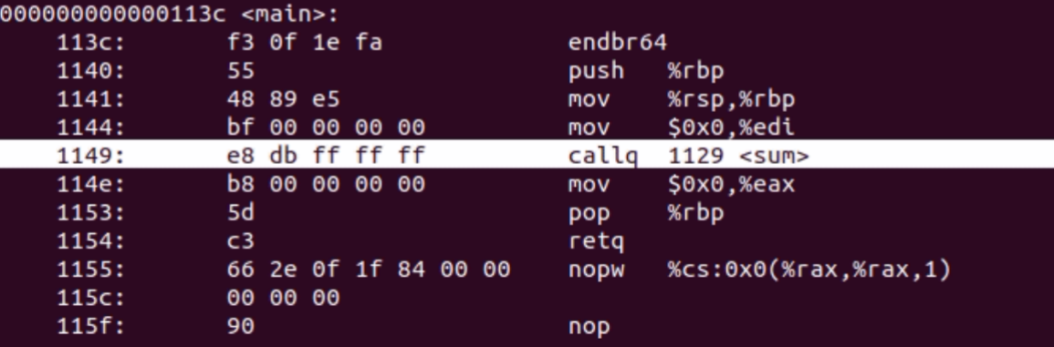
Demo 2
Notes:
这里显示了这两块代码在内存中的位置，sum从1129开始，而main又恰好知道sum在1129，为什么？因为这是虚拟地址，不是真正的物理地址

Slide 22
Address Binding
Binding: Mapping one address space to another
Relocatable address
Absolute address
Notes:
1. Address conflict demo
2. Sum demo: the jump address of sub-function [callq]

Slide 23
Virtual Memory

Slide 24
Logical vs. Physical Address Space
The concept of a logical address space that is bound to a separate（独立的） physical address space is central（重要） to proper memory management
Logical address – generated by the CPU; also referred to as virtual address
Physical address – address seen by the memory unit
Logical address space is the set of all logical addresses generated by a program
Physical address space is the set of all physical addresses generated by a program

Slide 25
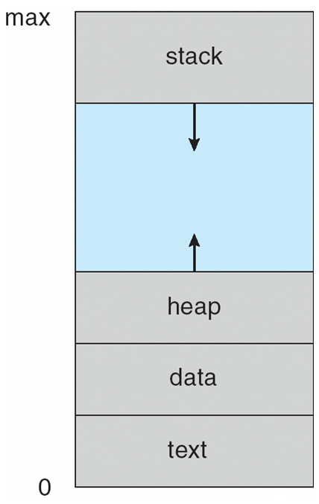
Virtual Address Space

Slide 26
Pros and Cons of VM
Pros
Low programming complexity
Larger memory for programs
Higher efficiency of physical memory usage
More protection strategies
More sharing strategies
Cons
Complexity in OS design
V.A. to P.A. translation cost time

Slide 27
Summary
Virtual memory translation
Physical memory space usage
Memory access efficiency
Memory protection

Slide 28
Memory Management: Hardware Support

Slide 29
Memory-Management Unit (MMU)
Hardware device that at run time maps virtual to physical address
VA
PA
CPU
MMU
Memory
DATA
virtual address
space
physical address
space
Notes:
mmu inside cpu
mmu and cache?
Intel: 48 vir vs 52 phy

Slide 30
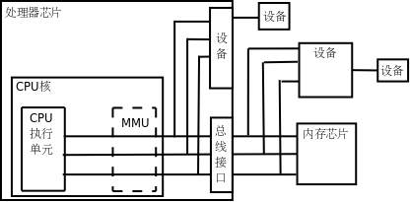
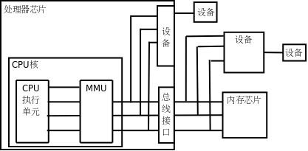
Memory-Management Unit (MMU)
MMU per CPU core
Notes:
Memory-Management Unit

Slide 31
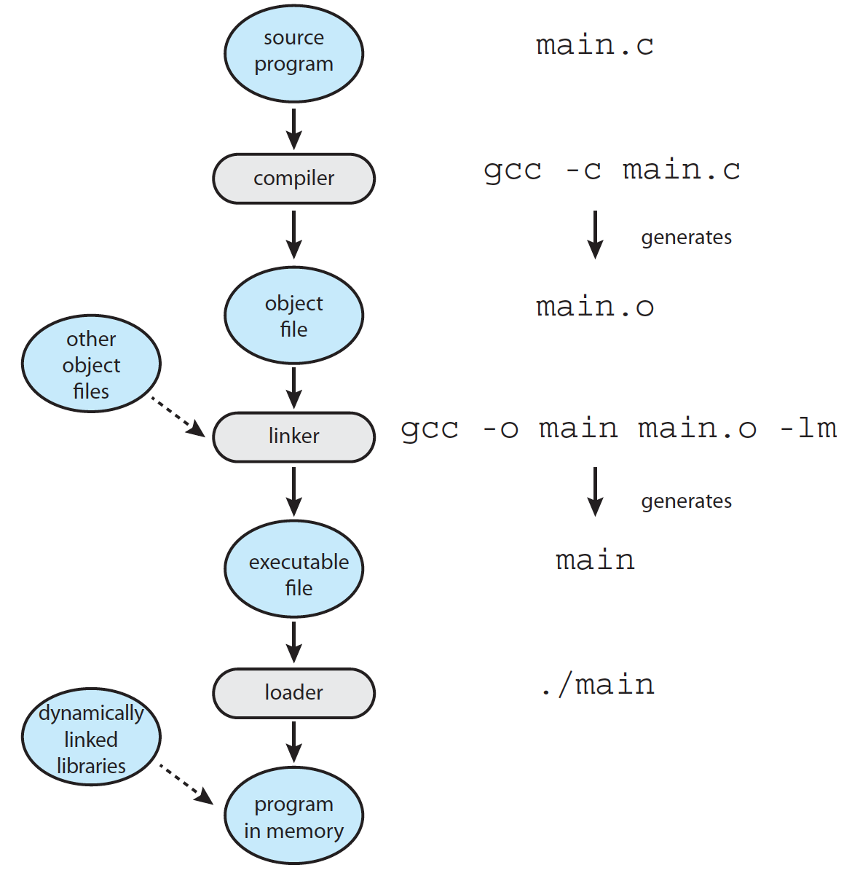
Multistep Processing of a User Program
Notes:
动态加载：当程序需要被调用时才会被加载。当一个程序调用另一个程序，首先检查那个程序是否已加载，如果没有，可重定位链接程序会加载所需程序到内存，并更新程序的地址表以反应这一变化。
动态链接：在运行时链接需要的库。动态链接库是二进制文件，所以不用编译。
编译时：
编译器生成代码时，CPU会为程序中的变量和代码分配相对地址。这些地址是相对于程序的起始地址的偏移量。
链接时：
链接器将编译后的代码和数据整合成一个可执行文件，并为程序的各个部分（代码段、数据段、堆、栈等）分配静态地址。这些地址在链接时是虚拟的，因为它们还未与物理内存地址关联。
加载时：0
当程序被加载到内存中运行时，操作系统的内存管理单元（MMU）会将这些静态虚拟地址映射到物理内存地址。这个过程涉及到内存分配和地址转换。
运行时：
程序执行时，操作系统负责管理虚拟地址到物理地址的映射。当程序访问内存时，MMU会将虚拟地址转换为对应的物理地址。
如果程序请求更多的内存（例如，通过动态内存分配），操作系统会分配新的虚拟地址空间，并在需要时将其映射到物理内存。

Slide 32
Memory Management Strategies

Slide 33
Memory Management Strategies
Contiguous memory allocation
Segmentation
Paging

Slide 34
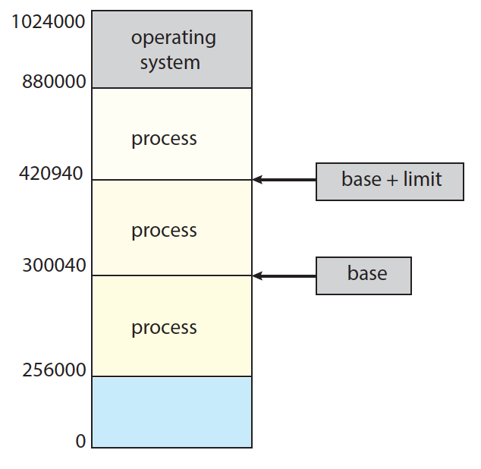
Relocation Registers

Slide 35
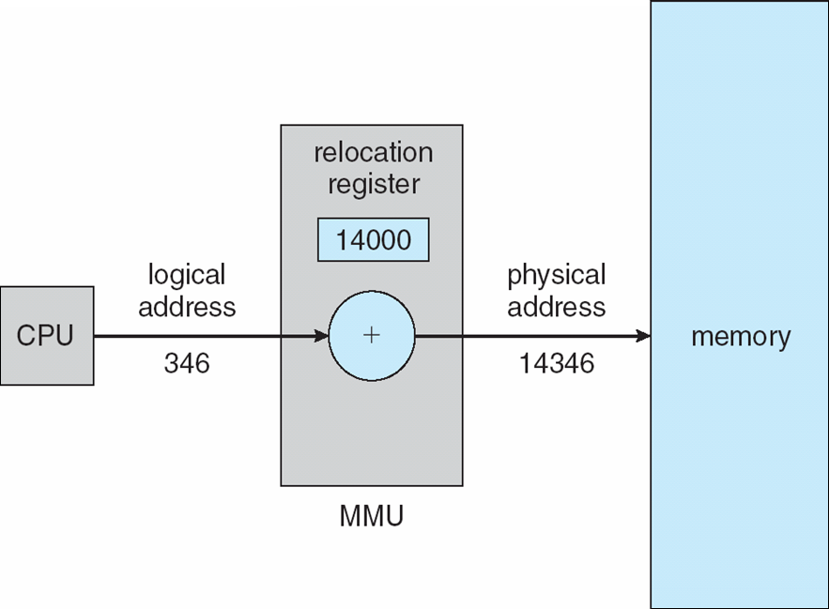
Dynamic relocation using a relocation register

Slide 36
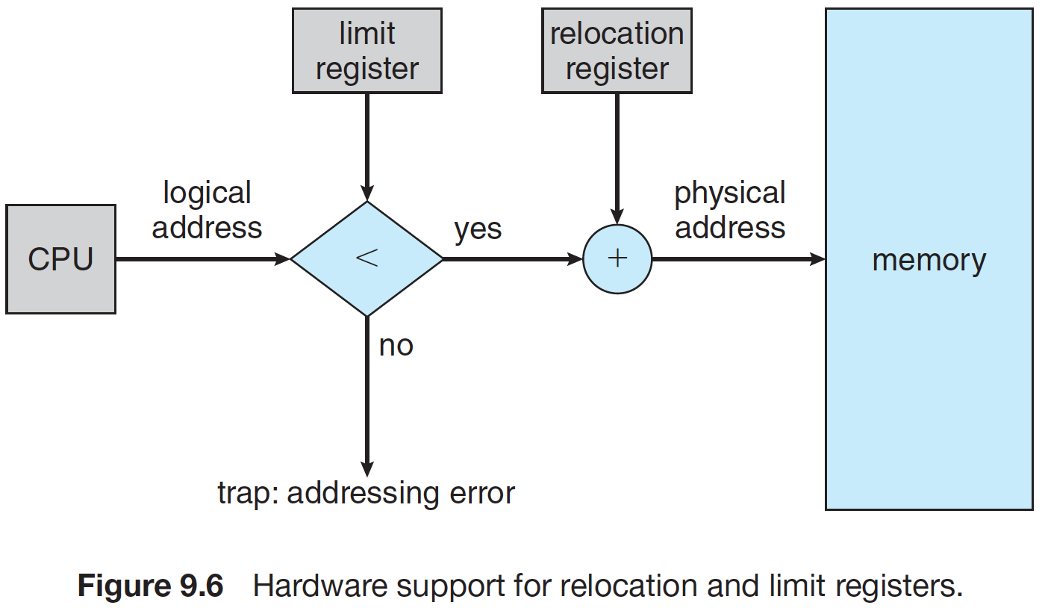
Protection
Notes:
要看offset是否超出limit，超出会报错

Slide 37
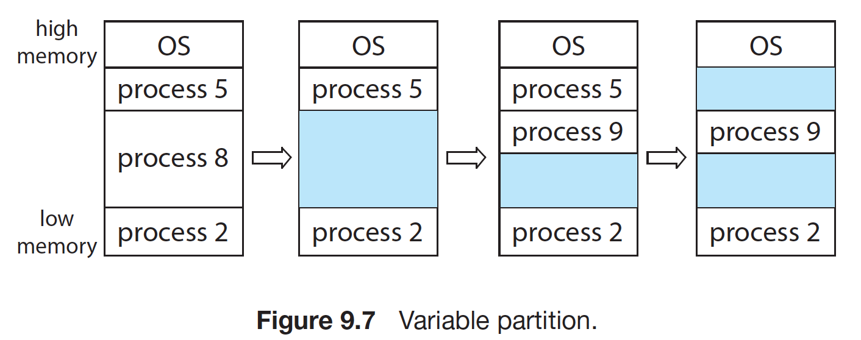
Contiguous Memory Allocation
可变分区
Hole
Notes:
Variable partition（可变分区）：内存中有一个set，包含不同大小的hole，OS根据进程的内存需求和可用内存的情况，决定哪些进程可以分配到内存。

Slide 38
Dynamic storage-allocation problem
solutions
First-fit: Allocate the first hole that is big enough
Best-fit: Allocate the smallest hole that is big enough; must search entire list, unless ordered by size（除非排序）
Produces the smallest leftover hole（能产生最小剩余hole）
Worst-fit: Allocate the largest hole; must also search entire list
Produces the largest leftover hole
0 | 4 | 8 | 12 | 16 | 20 | 24 | 28 | 32 | 36
Notes:
如何根据一组空闲的hole来分配大小为n的请求
Purple：used
Green: free
Now: request 4

Slide 39
Fragmentation
External Fragmentation（外部碎片） – total memory space exists to satisfy a request, but it is not contiguous
0 | 4 | 8 | 12 | 16 | 20 | 24 | 28 | 32 | 36
Notes:
不管是那种fit，都会产生external fragmentation
Purple: used
Gree: free
Request 12 都不行

Slide 40
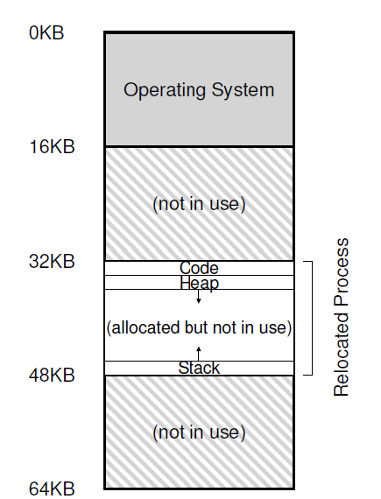
Fragmentation
Internal Fragmentation
allocated memory may be slightly larger than requested memory; this size difference is memory internal to a partition, but not being used
Notes:
为什么要用partition？维护几个字节的hole开销很大，不如直接分块。
当一个块的大小大于所分配进程所需要的大小，产生的也叫做internal fragmentation

Slide 41
Limitations of Contiguous
External fragmentation
Internal fragmentation

Slide 42
Deal with External Fragmentation
Reduce external fragmentation by
compaction（紧缩）
合并空闲空间
0 | 4 | 8 | 12 | 16 | 20 | 24 | 28 | 32 | 36
0 | 4 | 8 | 12 | 16 | 20 | 24 | 28 | 32 | 36
Notes:
必须要重定位是动态的，并且在运行时进行
首先移动code和data，再根据新基地址的值来改变基地址寄存器。

Slide 43
Deal with External/Internal Fragmentation
Non-contiguous memory allocation
Segmentation
Paging

Slide 44
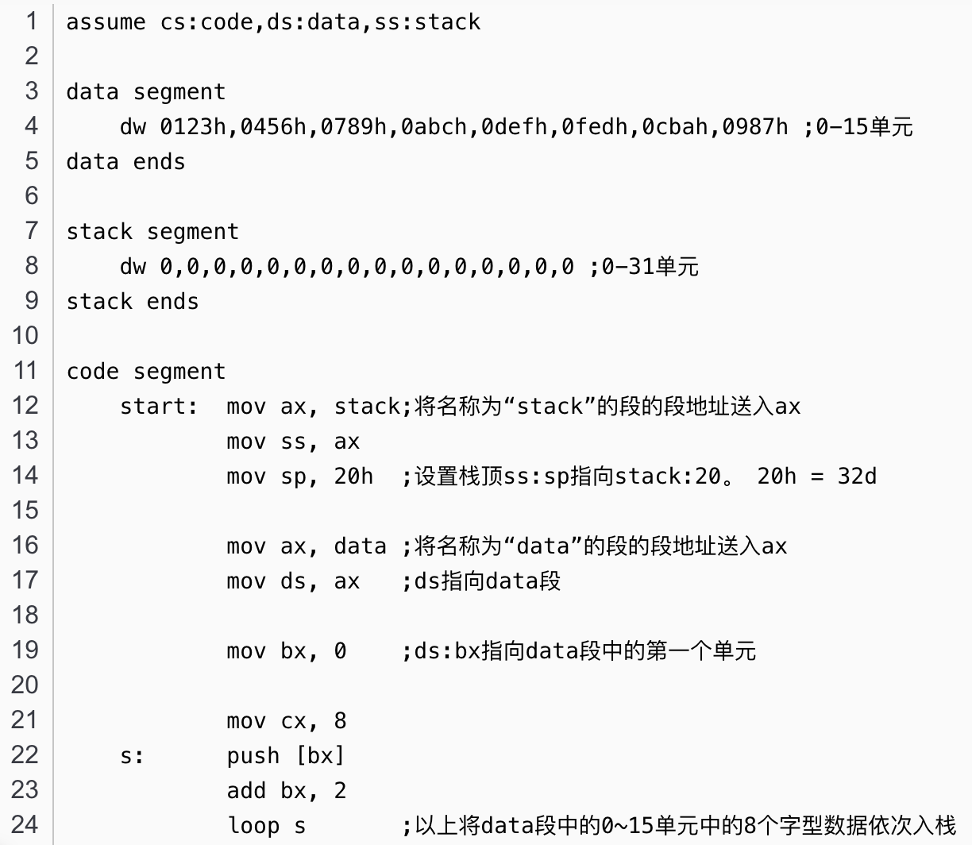
Assembly

Slide 45
Segmentation
A program is a collection of segments
main program
procedure
function
method
object
local variables, global variables
common block
stack
symbol table
arrays

Slide 46
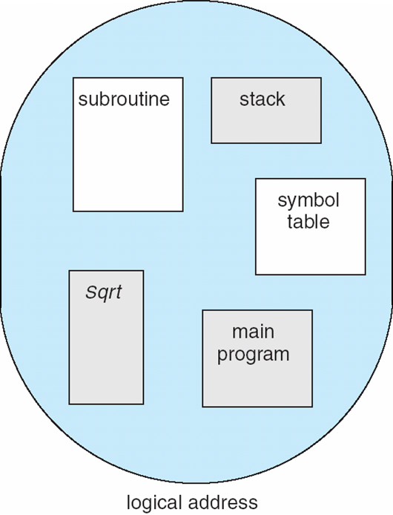
User’s View of a Program

Slide 47
Logical View of Segmentation
1
1
4
2
3
4
2
3
user space
physical memory space

Slide 48
Segment Table
Segment table – maps two-dimensional physical addresses; each table entry has:
base – contains the starting physical address where the segments reside in memory
limit – specifies the length of the segment
Segment-table base register (STBR) points to the segment table’s location in memory
Segment-table length register (STLR) indicates number of segments used by a program

Slide 49
Virtual Address in Segmentation
Logical address consists of a two tuple:
<segment-number, offset>
cs:ip
 | base | limit
0 | 0 | 50
1 | 50 | 100
2 | 150 | 200
3 | 350 | 50

Slide 50
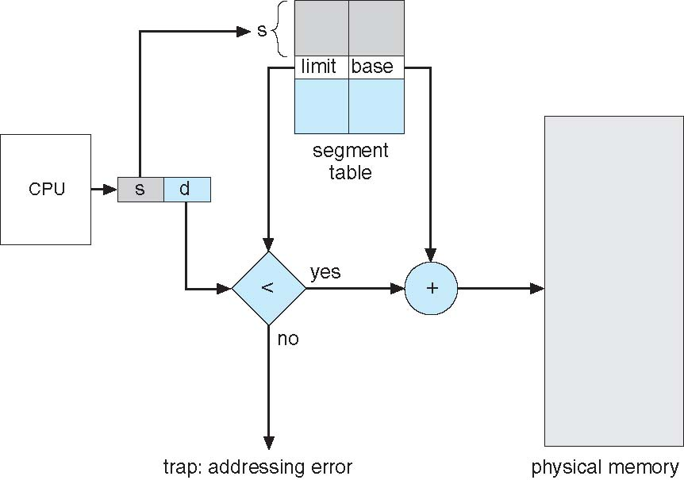
Segmentation Hardware
<segment-number, offset>
Notes:
CPU向总线发出logical address之后，逻辑地址被分为段号s和偏移d两部分，s从段表中匹配到相应段的limit和base对，如果d小于limit，则直接与base相加形成物理地址
一定注意逻辑地址包含的是段号segment number不是base，像page number一样

Slide 51
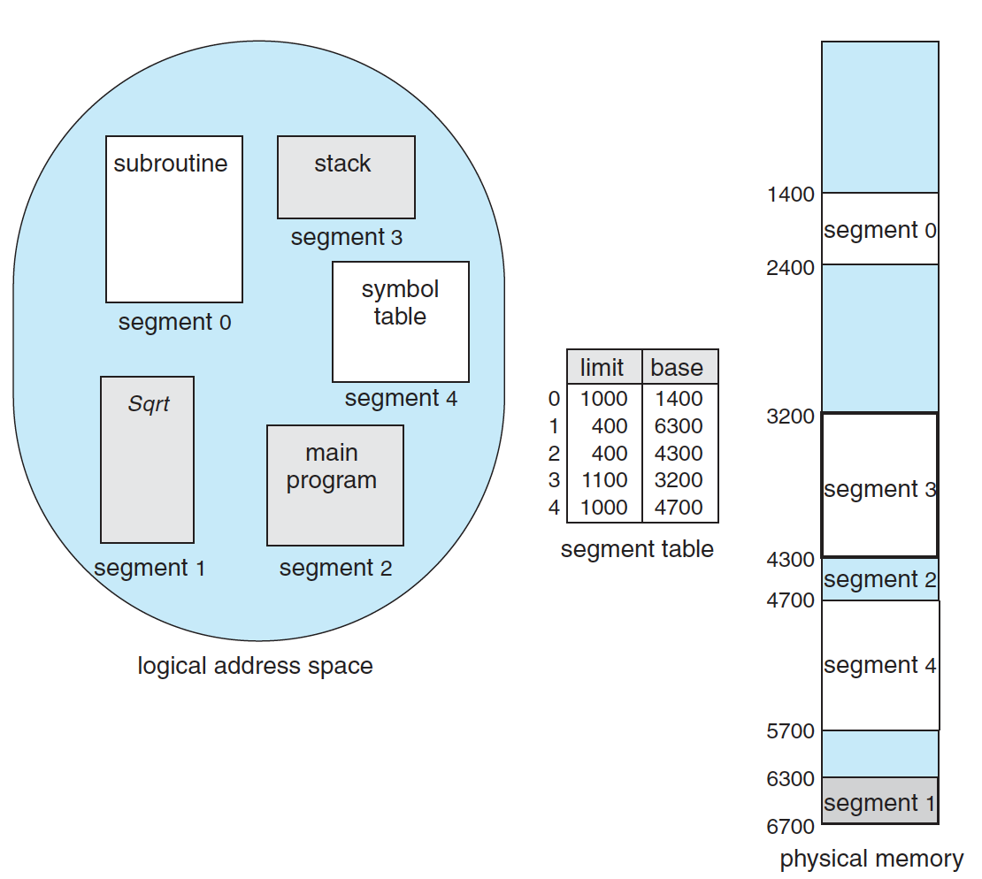
Example
<001, 000000011011>_{b}
<2, 1FF>_{h}
<3, 00F>_{h}
Notes:
Virtual address: 15 bits

Slide 52
The End of Chap 8 (1)
Notes:
Tlb miss
Cache miss
Page fault

Slide 53
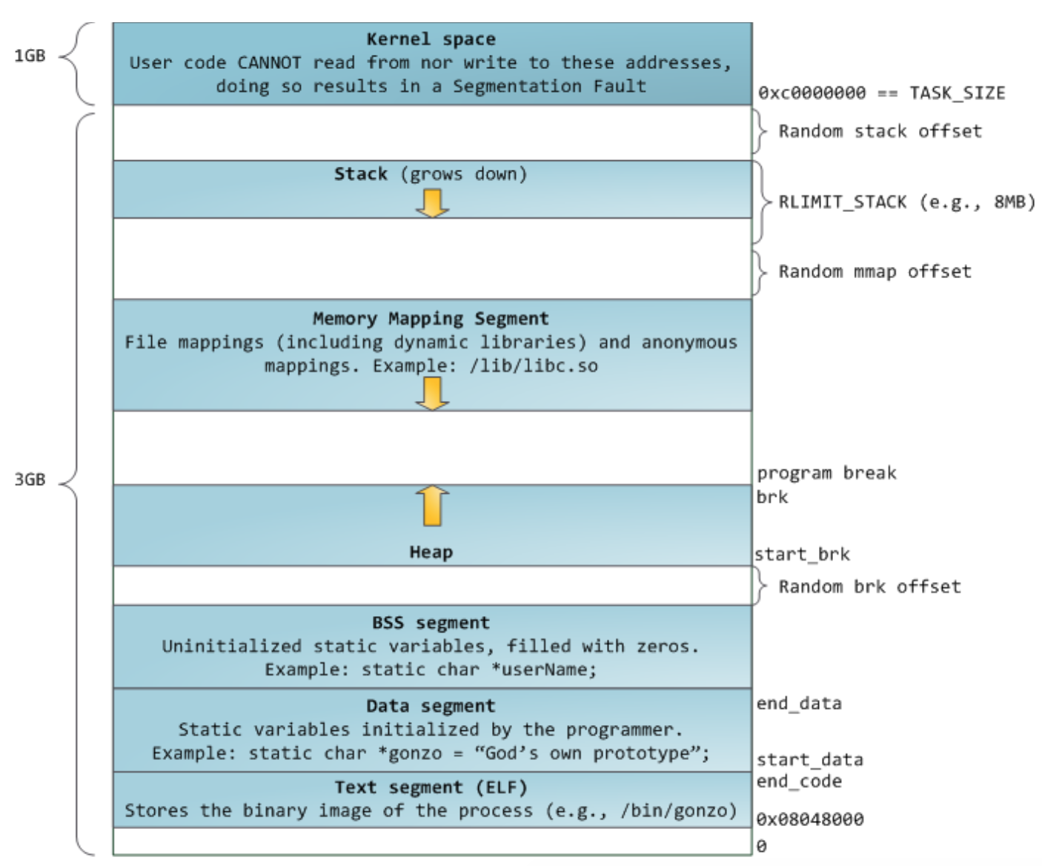
Virtual Address Space (32 bit)

Slide 54
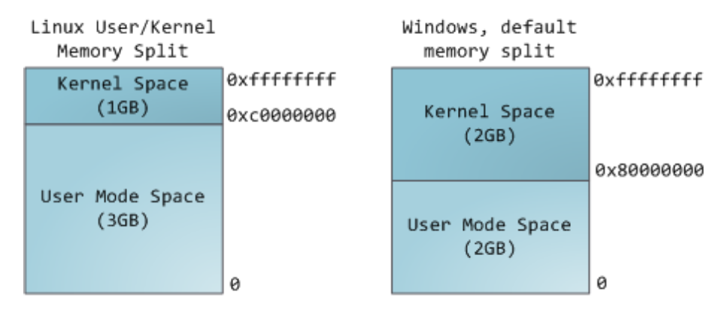
Virtual Address Space (32 bit)

Slide 55
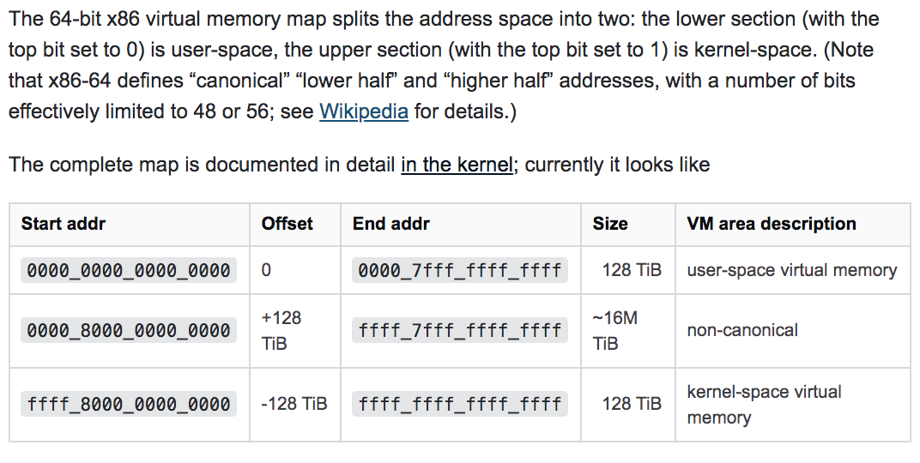
X86-64 Linux
Kernel space 128T
User space 128T
48 bits (not 64) virtual address space
Notes:
https://www.kernel.org/doc/html/latest/x86/x86_64/mm.html
https://unix.stackexchange.com/questions/509607/how-a-64-bit-process-virtual-address-space-is-divided-in-linux
https://stackoverflow.com/questions/6716946/why-do-x86-64-systems-have-only-a-48-bit-virtual-address-space
https://stackoverflow.com/questions/46509152/why-in-x86-64-the-virtual-address-are-4-bits-shorter-than-physical-48-bits-vs
https://stackoverflow.com/questions/63975447/why-virtual-address-are-48-bits-not-64-bits

Slide 56
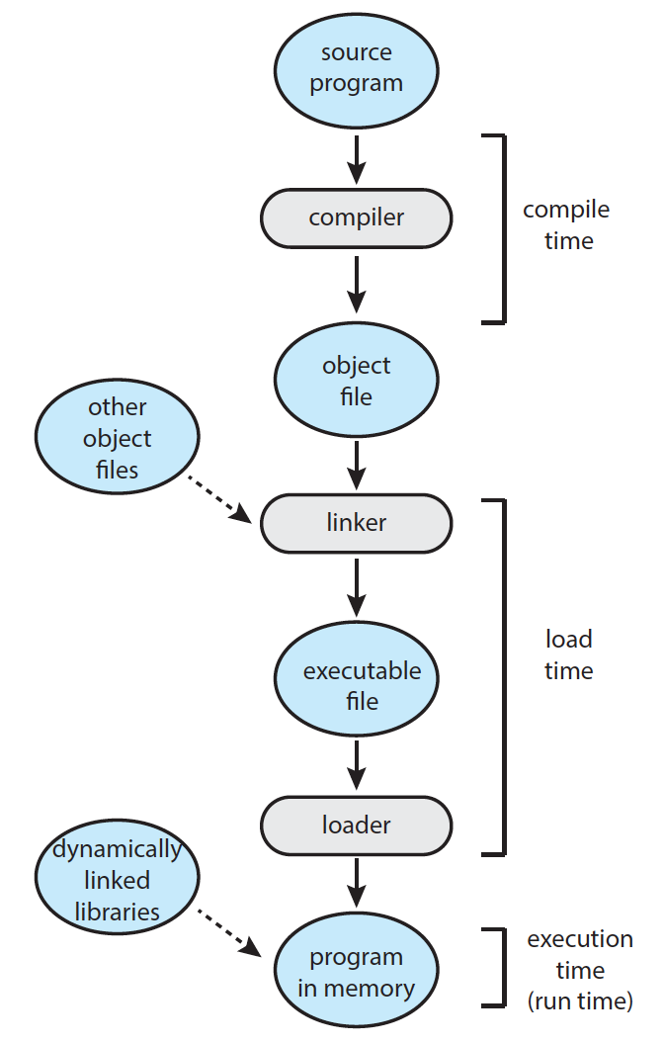
Dynamic Linking and Shared Library
Save space
Disk
Memory (shared)
Facilitate update
Notes:
objdump -d main
//dynamic linking
gcc -shared -fpic -o libvector.so addvec.c mulvec.c
gcc main.c ./libvector.so
//static linking
gcc -c addvec.c mulvec.c
ar rcs libvector.a addvec.o mulvec.o
gcc main.c -L. -lvector

Slide 57
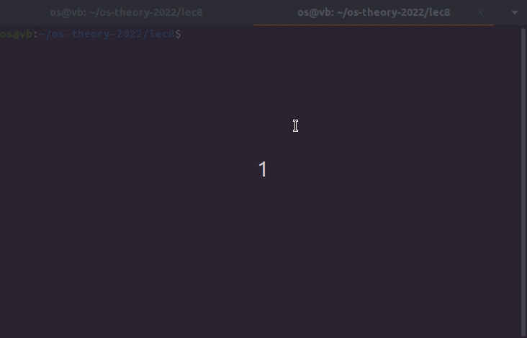
Demo

